Slide 1

BLOOD BREATHE
AN ANDROID APP

Slide 2
OUTLINE
INTRODUCTION
PROBLEM STATEMENT
OBJECTIVES
METHODOLOGY
RESULTS

Slide 3
INTRODUCTION
The main aim of this project is to save lives of people by providing blood.
Our project Online Blood Bank system using Android is developed so that users can view the information of nearby hospitals, blood banks and volunteer donors.
This project is developed by four perspectives i.e. hospital, blood bank, volunteer donors and patient.
This application we are developing helps to select the nearby hospitals, blood banks, donors online instantly by tracing its location using GPS.
This application reduces the time to a greater extent that is searching for the required blood through blood banks and hospitals.
Thus this application provides the required information in less time and also helps in quicker decision making.

Slide 4
PROBLEM STATEMENT
PROBLEM
The major problem in old Blood banking systems was that, they don't follow the actual needs of users.
Traditional blood banking systems were developed by 1 or 2 perspective.
Tracking the database was complicated when the details are maintained manually.
There was shortage and sometimes unavailability of rare blood groups due to less modules i.e. patient and donors.
SOLUTION
A better idea is to use the application which Mobile device is very popular with people too.
This application is providing each entity the facility to approach nearby blood donors so that it will become much easier to search rare blood groups in the hour of need.

Slide 5
OBJECTIVES
To bridge the gap between blood banks, hospitals, volunteer donors and needy people, through this system.
To facilitate the search process for needy people and make it easier than before.
To reduce the data entry process.
To use GPS service for locating the hospitals, blood banks & volunteer donors to know if the seeker is near to or not.
Some blood types are rare so the system can find the required donors with the required blood type easily from the huge database by using search feature in the android app.
To provide dynamic database that is storing donors Information and can communicate with them easily.

Slide 6
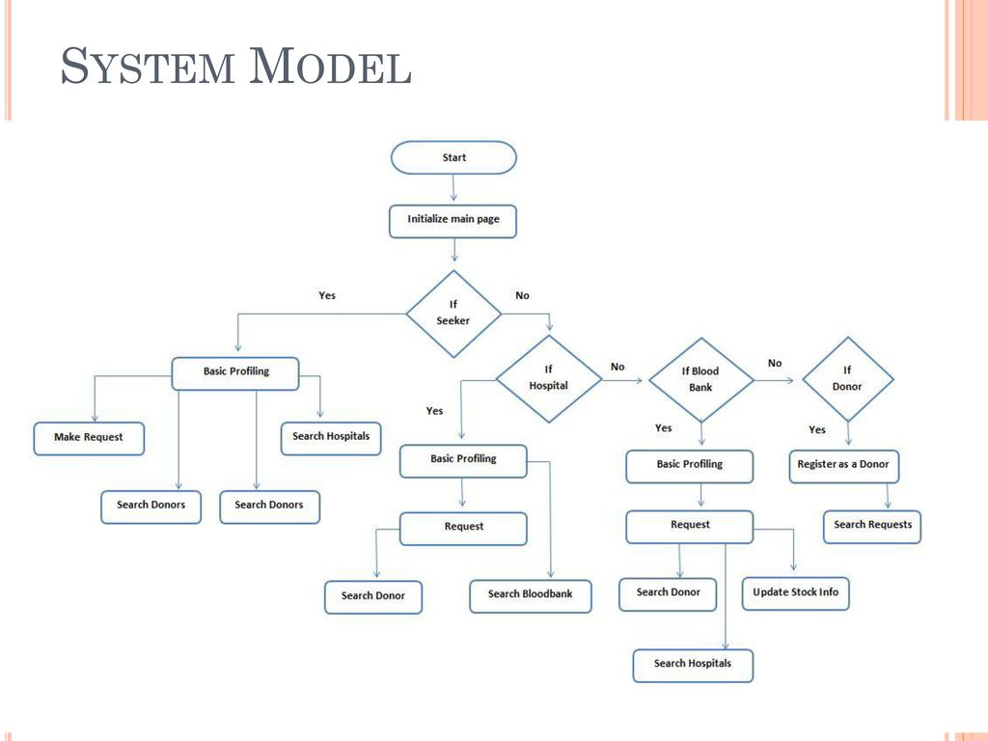
METHODOLOGY

Slide 7
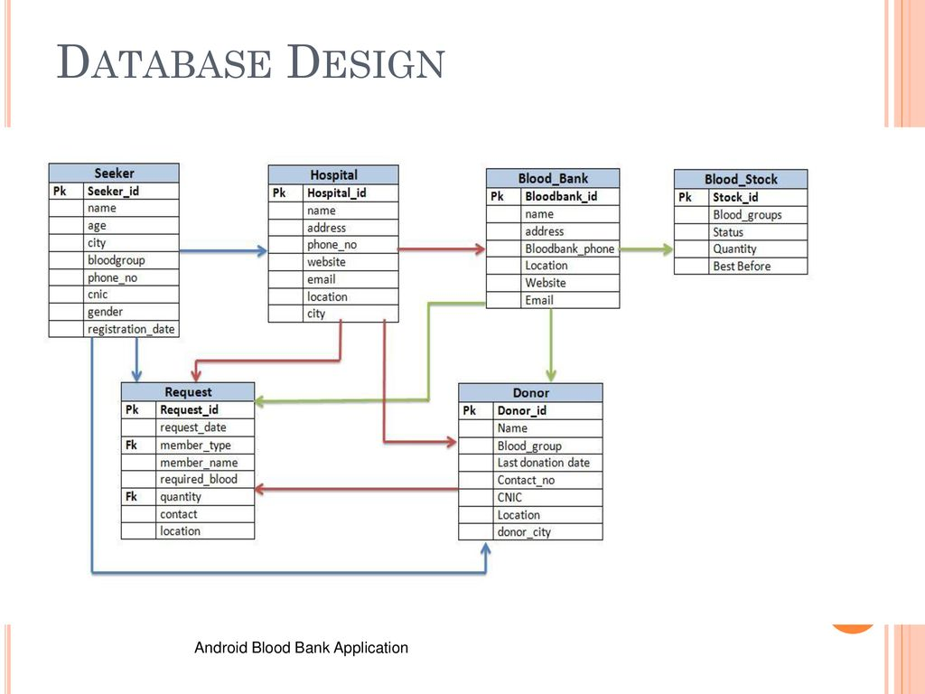

Slide 8
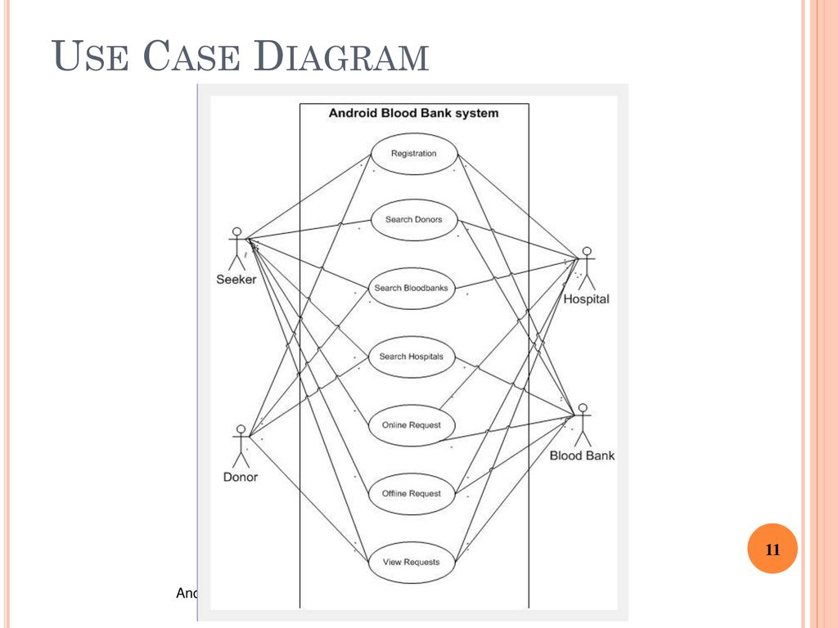

Slide 9
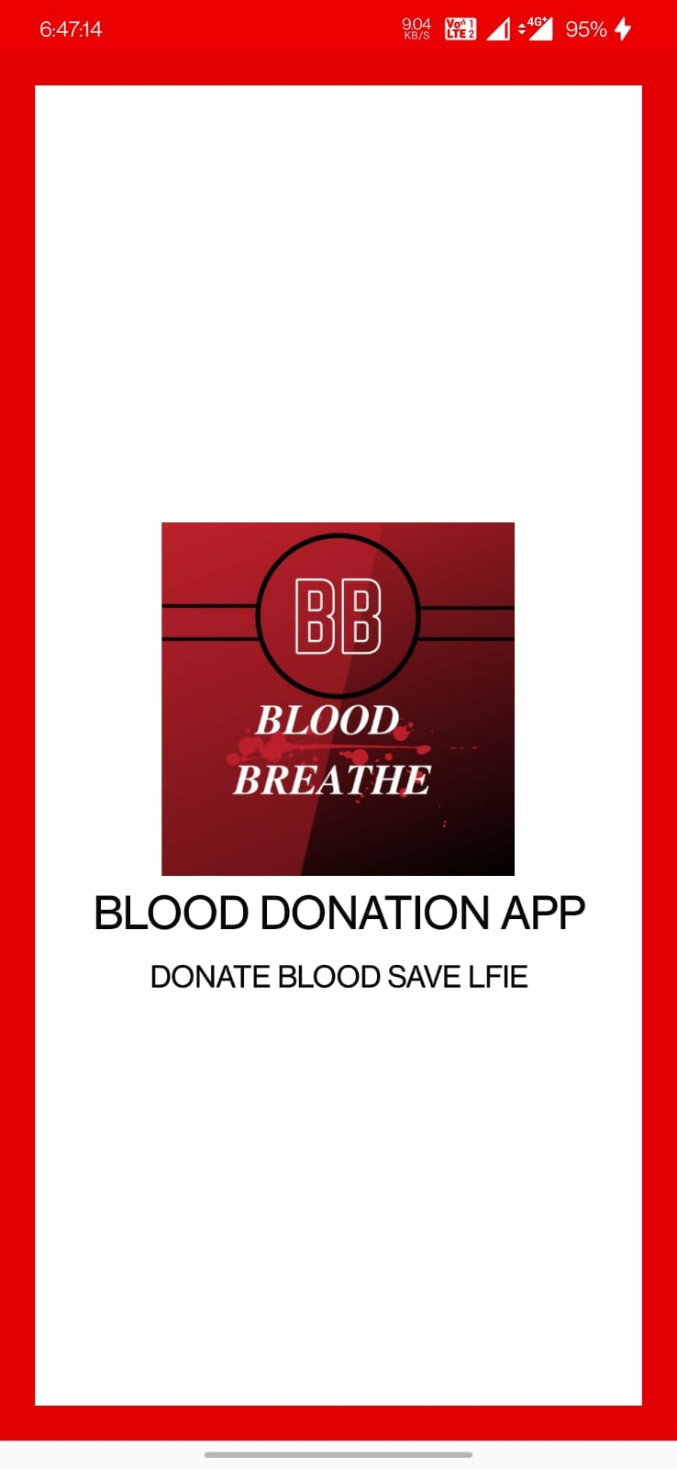
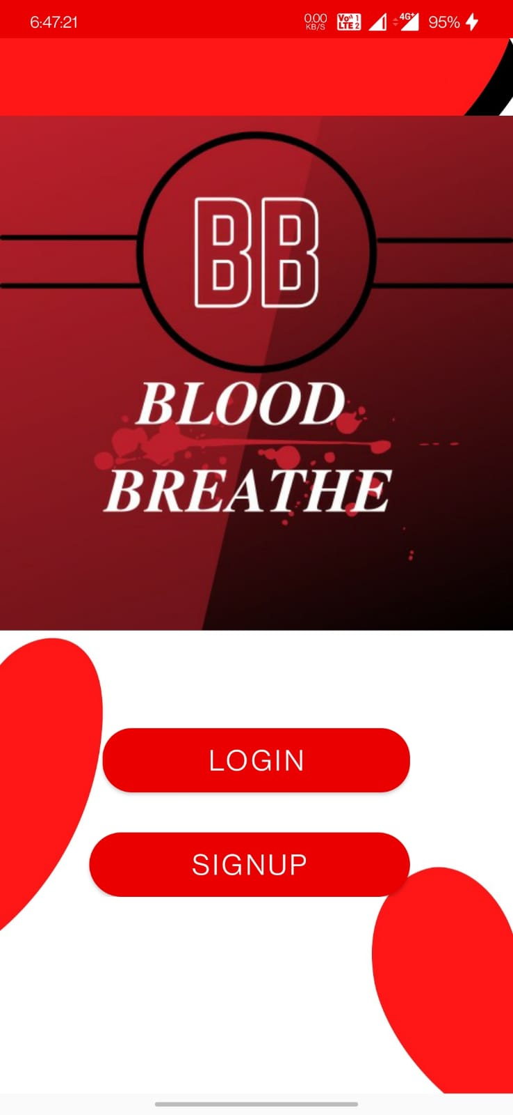
RESULTS
SPLASHSCREEN
SIGNUP PAGE
SPLASHSCREEN

Slide 10
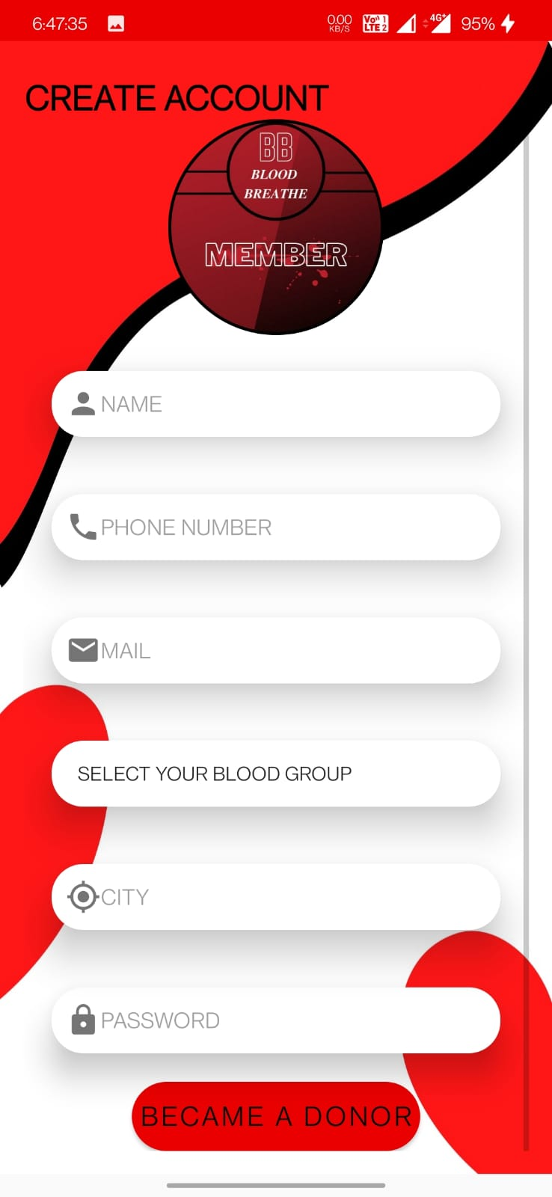
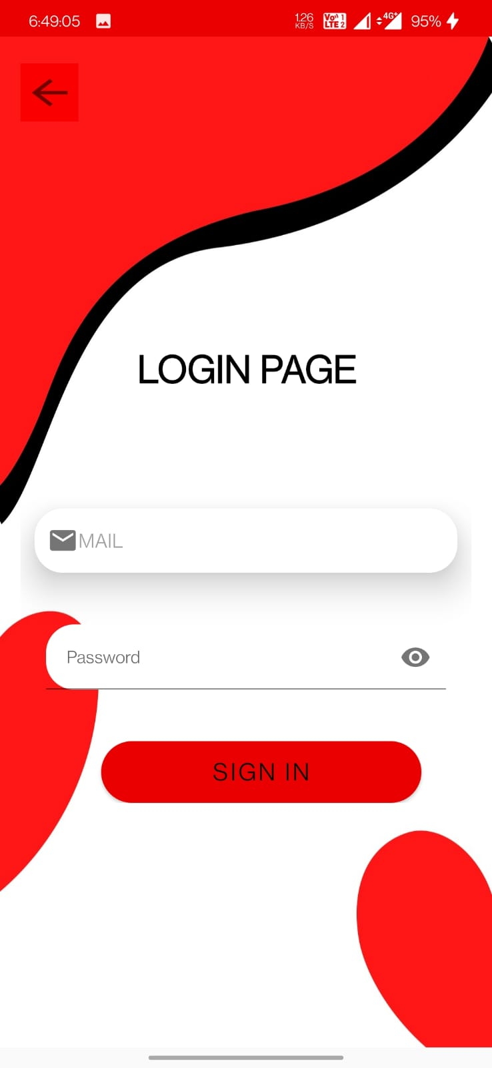
REGISTRATION PAGE
LOGIN PAGE

Slide 11
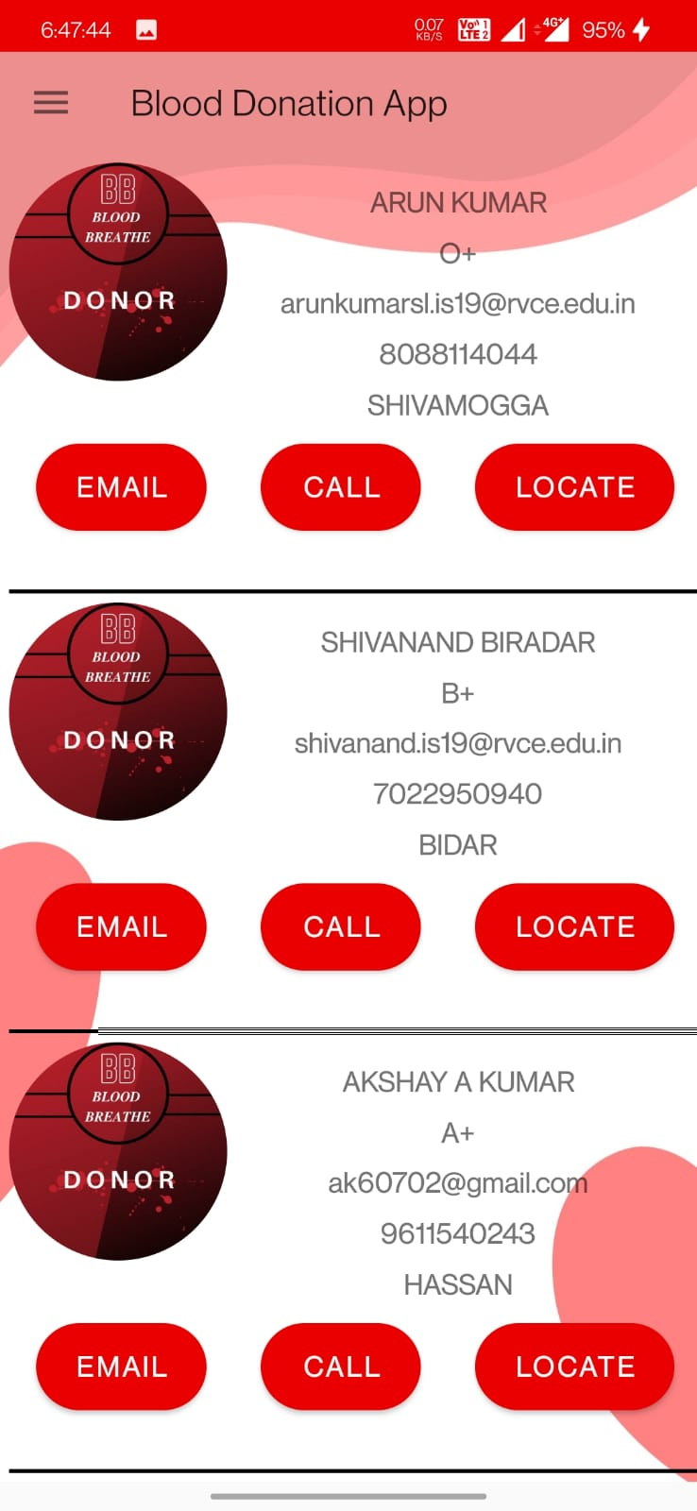
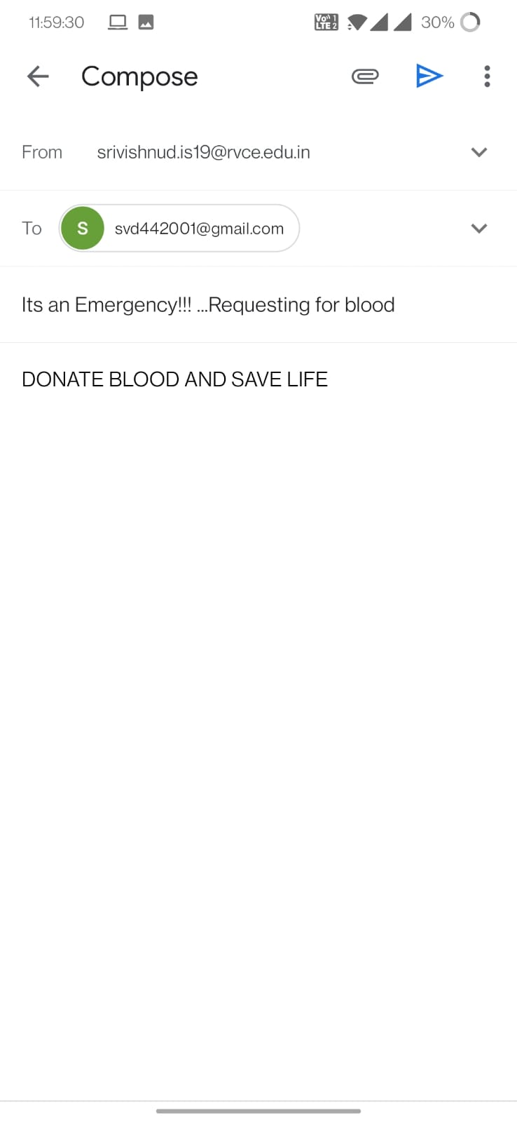
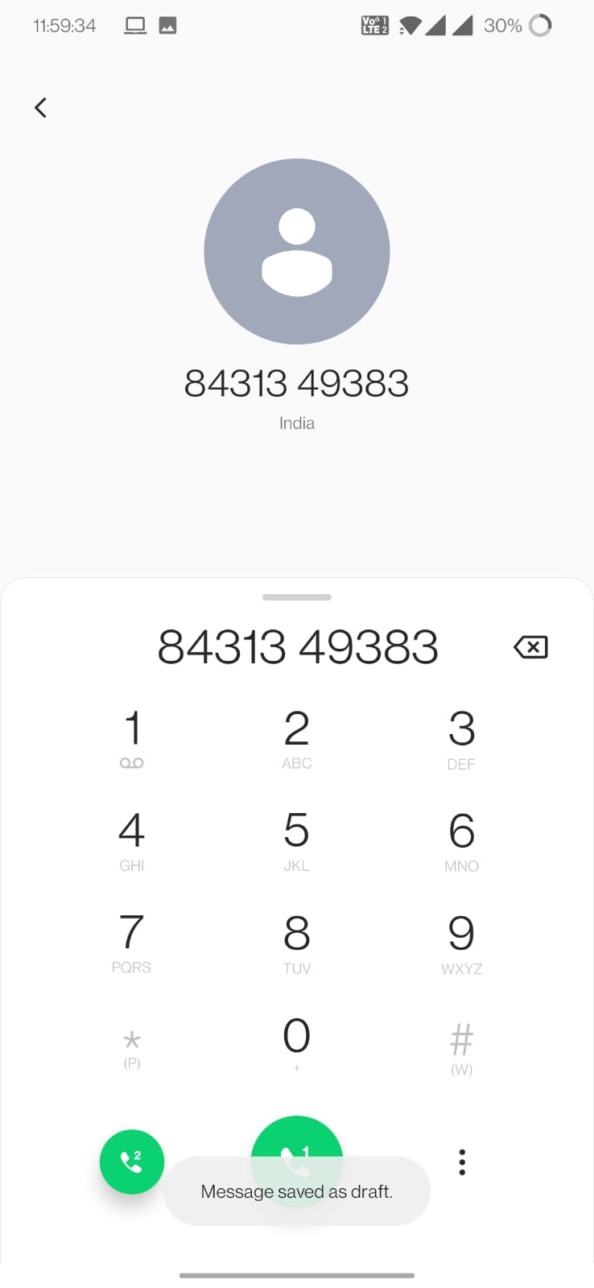
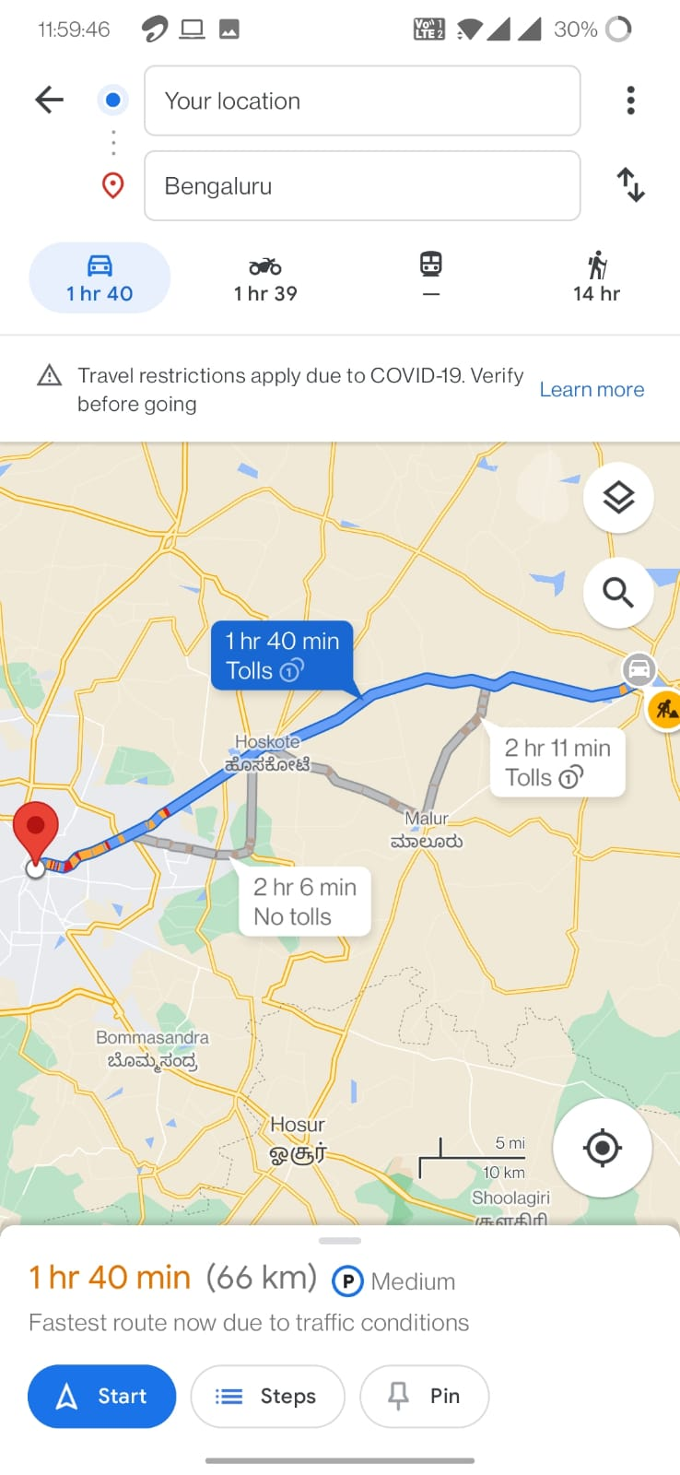
HOME PAGE
On clicking LOCATE
On clicking EMAIL
On clicking CALL

Slide 12
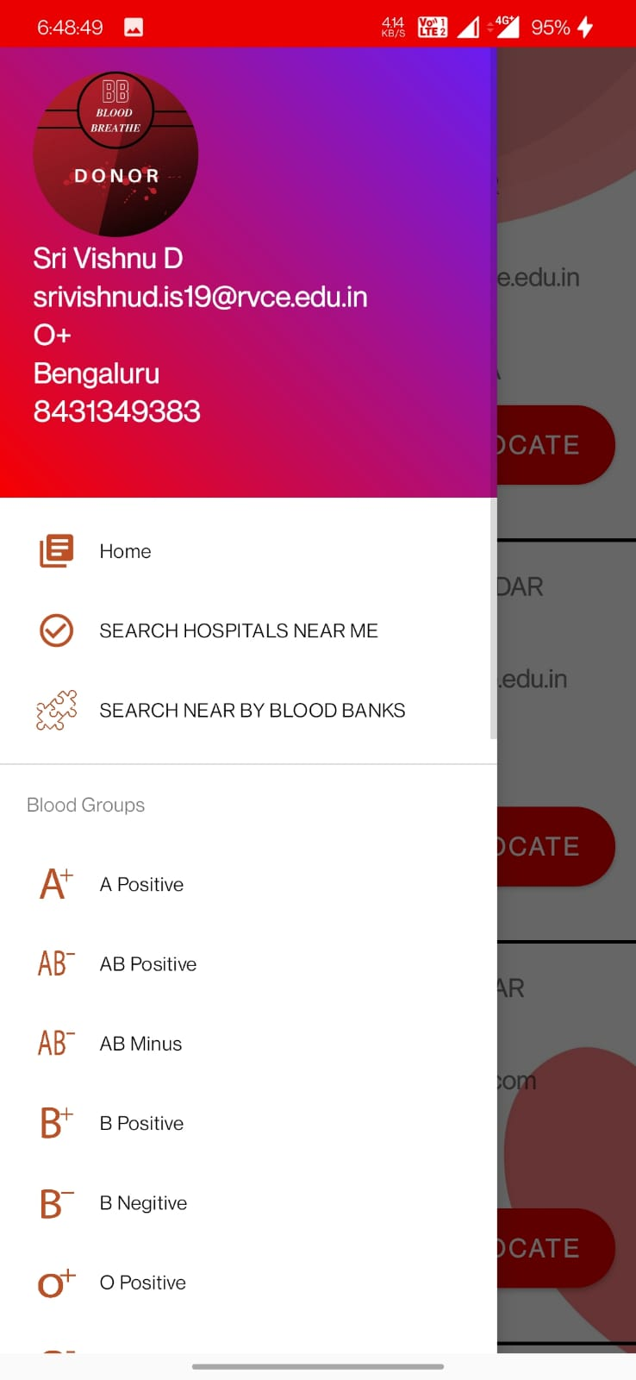
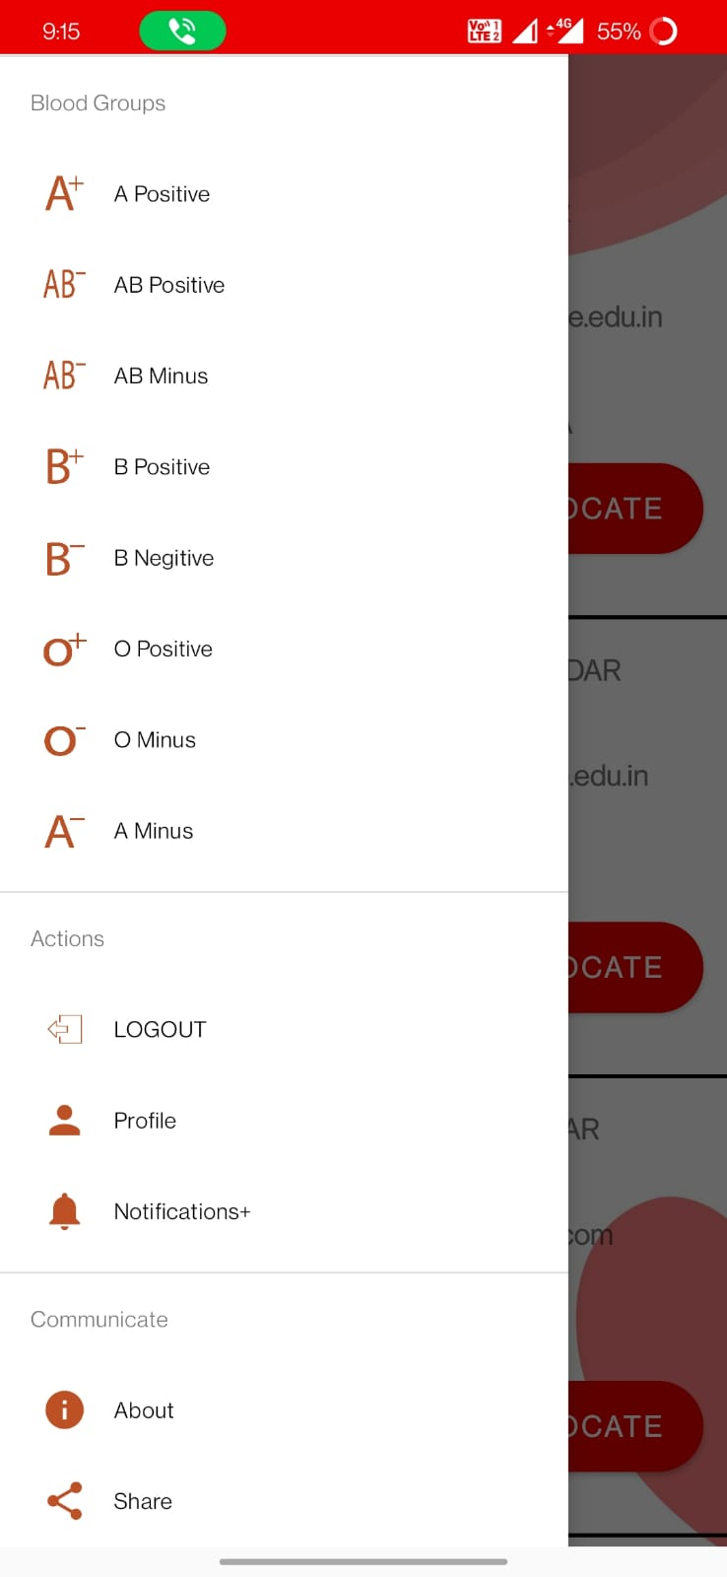
HOME PAGE
NAVIGATION BAR

Slide 13
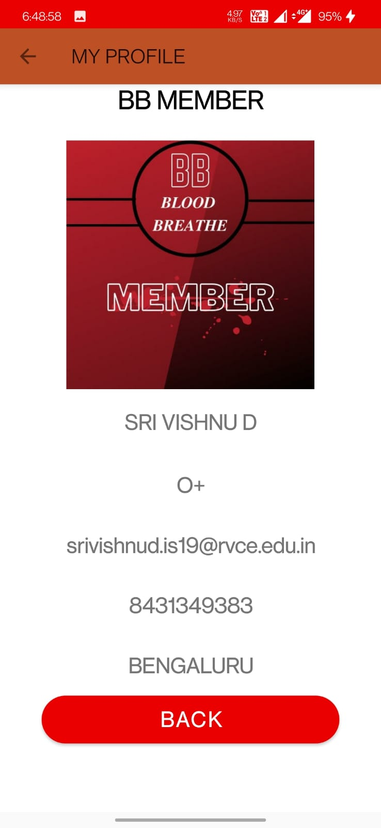
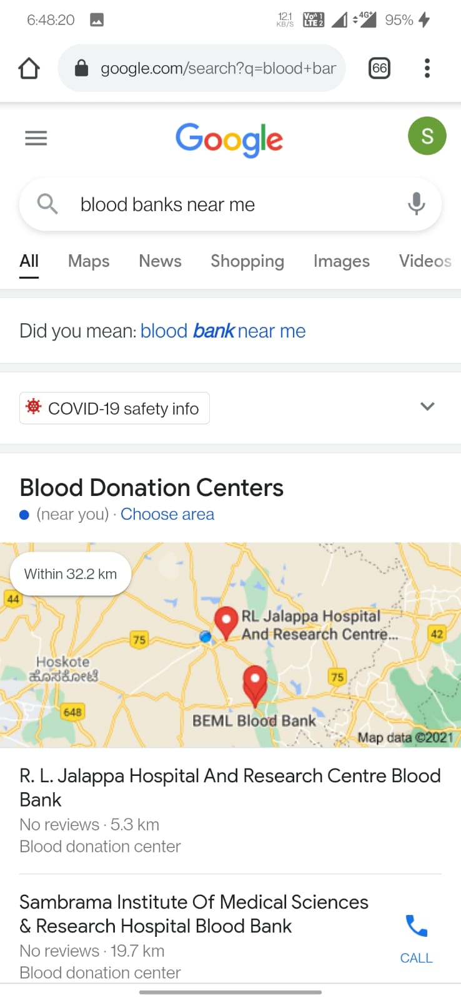
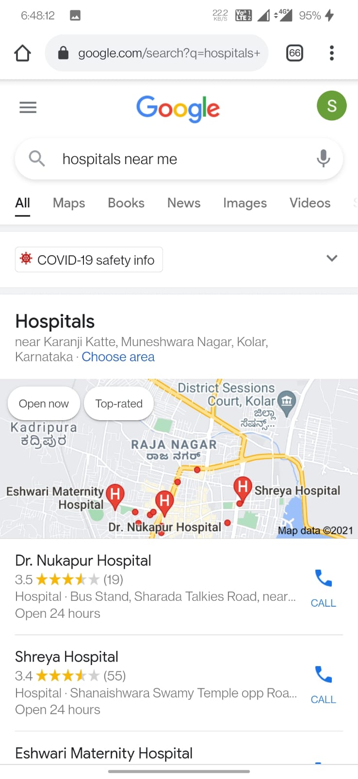
PROFILE PAGE

Slide 14
USES OF THIS APP
PRESENTLY THE APP IS IN DEVELOPING PHASE .
THOSE WHO ARE IN NEED OF THE BLOOD CAN USE OUR APP TO FIND THE NEAR BY DONORS WITHIN A MINUTE .
IF THE DONORS OF THE SAME BLOOD GROUP ARE FOUND IN THEIR LOCALITY THEN THEY CAN EASILY CONTACT THEM EITHER BY A CALL OR BY EMAIL
EVEN THEY CAN LOCATE THE DONORS IN MAP AND CAN CONTACT THOSE WHO ARE IN NEAR TO THEM.

Slide 15
GIT HUB REOP LINK OF APP TILL NOW
https://github.com/SRIVISHNUD442001/BLOOD_BREATHE_Blood_donating_app.git

Slide 16
THANK YOU

